Slide 1
CSC207 Project Blueprint Presentation
Presented by Team 24
Alice Baker
Yue Chen
Yuewen Zhang
Zhikang Tian
Notes:
[everyone should speak and the presentation should fit within ~3–5 minutes depending on the number of teams in the room]
[the following slides outline the suggested structure, but feel free to be creative!]

Slide 2
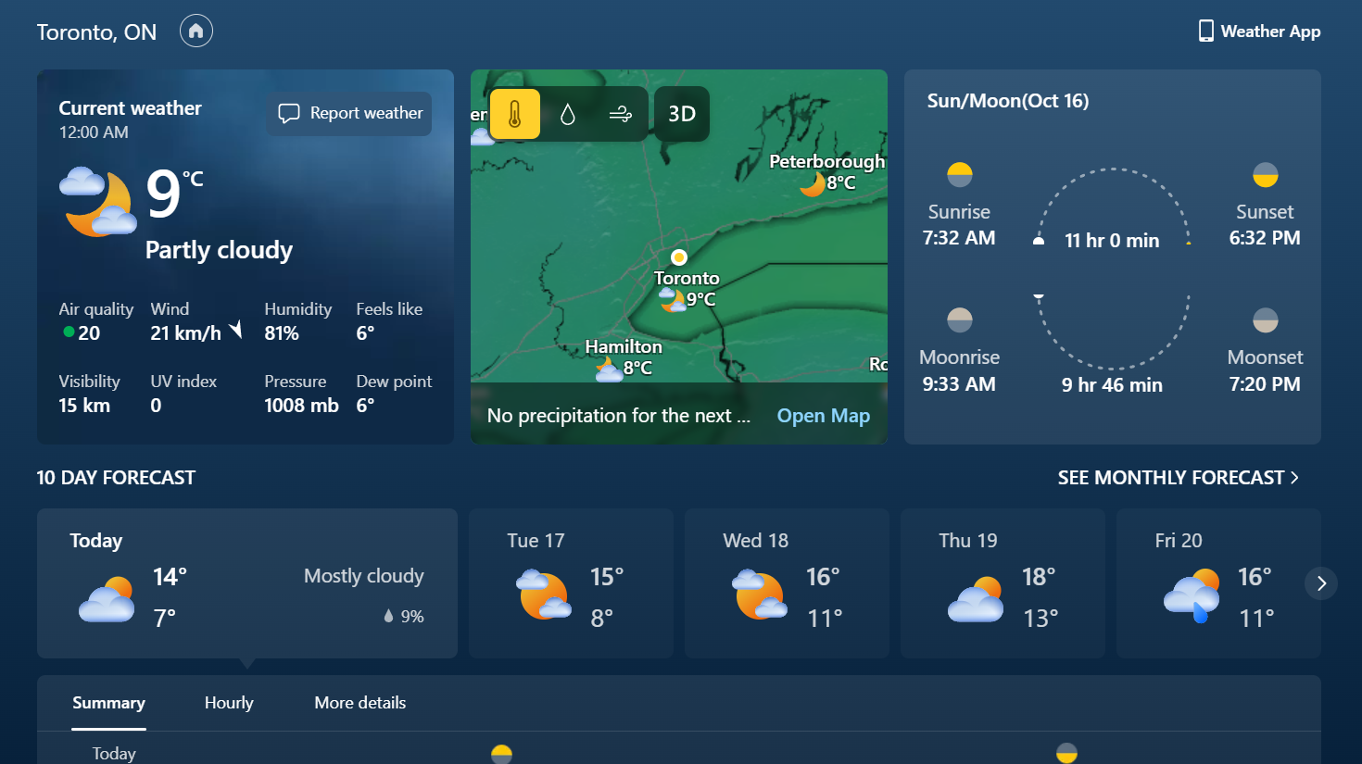
A New Advanced Personalized Weather System

Slide 3

WeatherCalendar
Basic usages:
Check the weather
Get advice based on personal preferences
Send weather notification to friends or family members
Form a group of different locations
Domain:
Advanced Personal Weather Calendar

Slide 4
User Stories

Slide 5

User Story 1 From Yuewen
A person is traveling from China to Los Angeles. She runs the weather system to see the weather in Los Angeles.
She is shown the weather in the next a few days and advice on clothing. She can also send a reminder to her family about the weather condition when she is on trip.
[Send and receive notification from users]

Slide 6

User Story 2 From Yue
An international student Stella is from China and learning in Toronto, Canada, as her family and friends are still in China, she has to celebrate the festivals both in China and Canada.
Weather Calendar provides an opportunity that shows Calendar in both Gregorian Calendar and Lunar Calendar, shows and reminds festivals of China and Canada. In addition, Stella’s mom can get notifications of the weather in Toronto and remind Stella to wear more when the weather is colder.
[Get reminders on festivals and home members when you are away]
此照片，作者: 未知作者，许可证: CC BY-SA

Slide 7

User Story 3 From Alice
A person whose family lives in Ireland, but he lives and works in Italy.
He plans trips back home in the weather calendar and is shown the time of day it is for his family back home, so he knows the best times to contact them) and the weather and advice on clothing for the duration of his trip.
[Care about your family when away from them]
此照片，作者: 未知作者，许可证: CC BY-SA

Slide 8

User Story 4 From Zhikang
John is collaborating in a project that has a team all across the world, some members are in Australia, some members are in the UK, some members are in China, while some members and John are in Canada. It was hard for them to schedule meetings and project testings as they live in different time zones and need to check the world clock for an appropriate time that everyone is online.
After the team switched to use Weather Calendar for communication, the time of each member shows next to the member’s profile photo, and when they set up a meeting, Weather Calendar shows what time is suitable for all members online based on each members’ preference.(Example: Sydney 11PM, Beijing 8PM, London 12PM, Toronto 8AM). It is easier for a team to schedule events.
[Group scheduling across different time zones]
此照片，作者: 未知作者，许可证: CC BY-SA

Slide 9
Team Story
Anne is a multinational company manager based in Toronto, and her colleagues are across the world, so she has a lot of business trips to visit each branch of her company.
She first registered an account and set up her home on the Weather Calendar, then added her secretary Jane as a friend. Jane shared their business trip to Hong Kong in two days for a week to Anne via private message. Later than that, Anne created a group of the managers of the branches all over the world, which is used to schedule a manager meeting function to make sure that the time is great for everyone.
Then, at night, she received the notification “Hong Kong, 20~31C during your trip, rain at arrival, have a great trip!” along with some clothing advice. When Anne arrived in Hong Kong, she was able to open her umbrella and arrived at the hotel without getting wet.
After dinner, she was reminded that “Manager meeting in 1 hour, starts at 8:00PM”, as the Weather Calendar recognized Anne moved into another time zone, so the meeting time automatically switched. At night, Anne got notified that “Home at Toronto will be colder, lowest temperature is 6C during the week”, then she called her family and reminded them to stay warm during the week.
After Anne came back to Toronto, she praised the Weather Calendar for the great features she used, it saves a lot of time for getting a schedule and reminders that she doesn't have to check multiple apps back and forth.

Slide 10
Specifications

Slide 11
Specification
Create your profile with your personal data like location, preferences¹.
Suggest users if an umbrella, winter coat is needed based on real-time weather conditions and user preferences².
(Not Decided Yet) Suggest user what is suitable to do for today based on "Tarot/Traditional Chinese Calendar".
(Not Decided Yet) Notification of special weather / natural events.³
Use of an API access to real time weather data.
(Not Decided Yet) Use of an API access to Tarot Card Reading.
*Additional specifications will be given and APP specification is tentative to change during implementation of the APP.
Notes:
1.Locations may contain the user's home city, hometown, place traveling soon.User preferences may contain if the user is a person like / afraid cold weathers, like / afraid warm weathers.
2. Example 1: if the user says he set A/C temp at home at 16C, then he will get “Bundle Up” notification only if weather is colder than others. Example 2: if the user is now on a business trip in Toronto, but his family is in Calgary, then he will get "Suggest your family members to wear more" if Calgary's temperature is dropping.
3. Example 3: Based on the user's location, if tonight got a high KP index, he might get a notification of "Possibly Aurora Appearance".
Show your software specification
Probably don’t read it right off the slide — choose key parts to emphasize and draw our attention to.
This could reasonably take more than one slide depending on how you format it.
Remember, keep this short and to-the-point given the limited time!

Slide 12
Proposed Entities
Personal Profile
Group
String username
Group group
String location
String password
int id
List groupmembers
List locations
List time

Slide 13

APIs Connected
Weather API
Tarot API

Slide 14
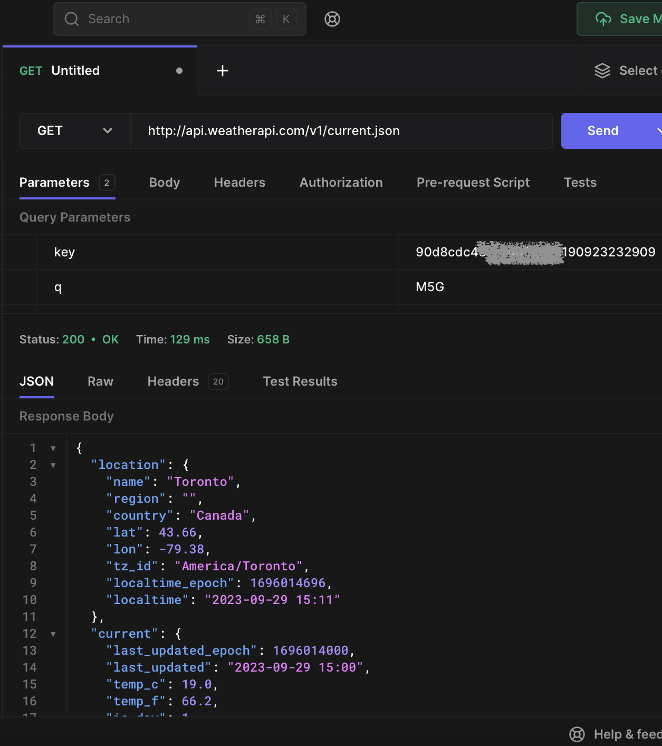
Weather API
We connected with Weather API from weatherapi.com, which is an API can help us get detailed weather conditions for both now and future forecast. We have chose this API as it is free for us to try out first with limited information but enough for early development.

Slide 15
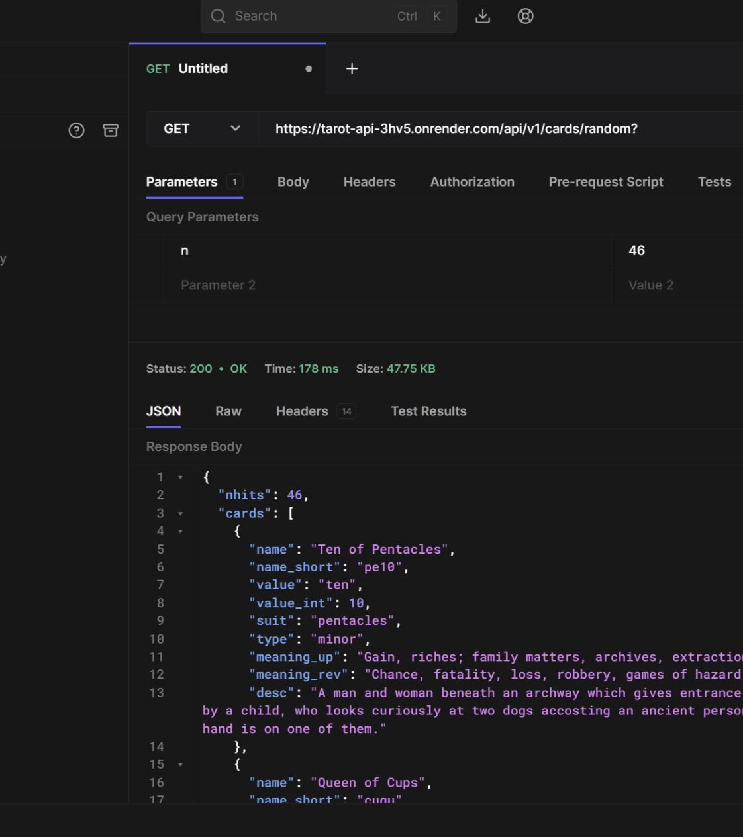
Tarot API
We connected with an open source Tarot database API, which contains Tarot Cards with explanation.

Slide 16

Thank you for your participation

